Slide 1
Spring 4
Introduction to Spring Boot
Notes:
Add instructor notes here.

Slide 2
Lesson Objectives
What is Spring Boot
How Spring Boot works
Developing web application using Spring Boot
Spring Boot integration with Spring
Data JPA
Notes:
Following contents would be covered:
What is Spring Boot
How Spring Boot works
Developing web application using Spring Boot
Spring Boot integration with Spring Data JPA
Add instructor notes here.

Slide 3
Spring Boot
Prerequisites to start working with Spring Boot
Knowledge of basic spring concepts
jdk 1.8 or higher
IDE i.e Spring STS ( has maven built into it)
Notes:
Spring STS can be downloaded from spring.io/tools

Slide 4
Ways to create Spring Boot project
Using the Spring Tool Suite IDE ( STS )
Spring Initializer
Spring command line interface

Slide 5
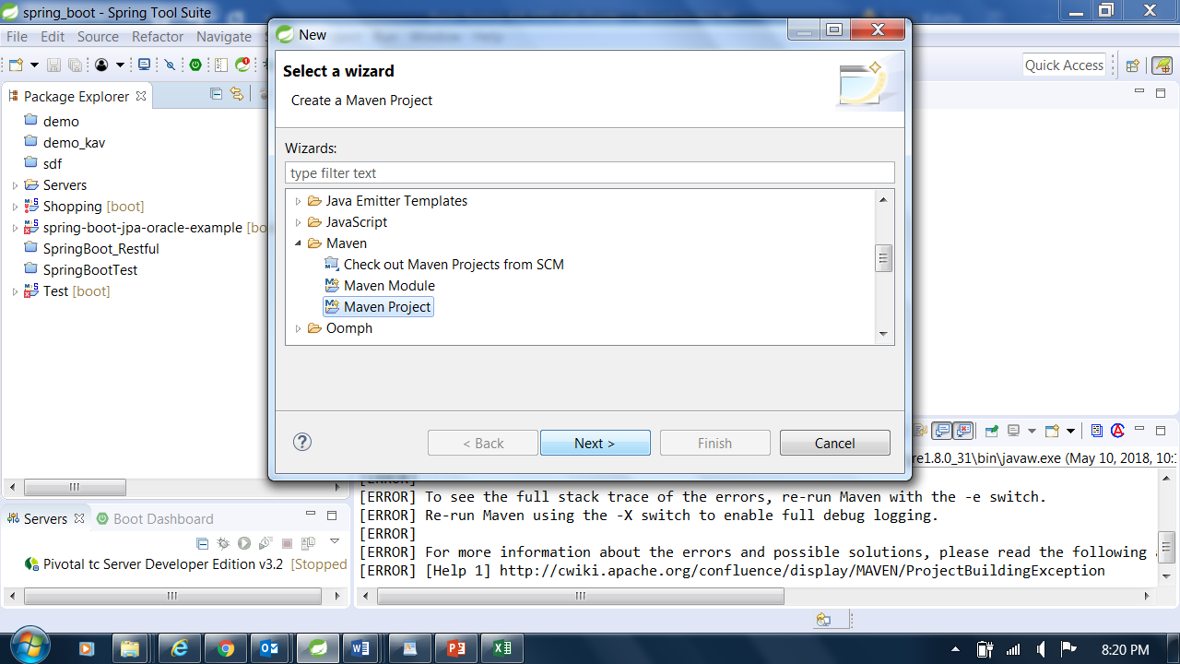
Creating a spring boot application using STS IDE Click on menu , File →New –Other - Maven -Maven Project- Click on Next

Slide 6
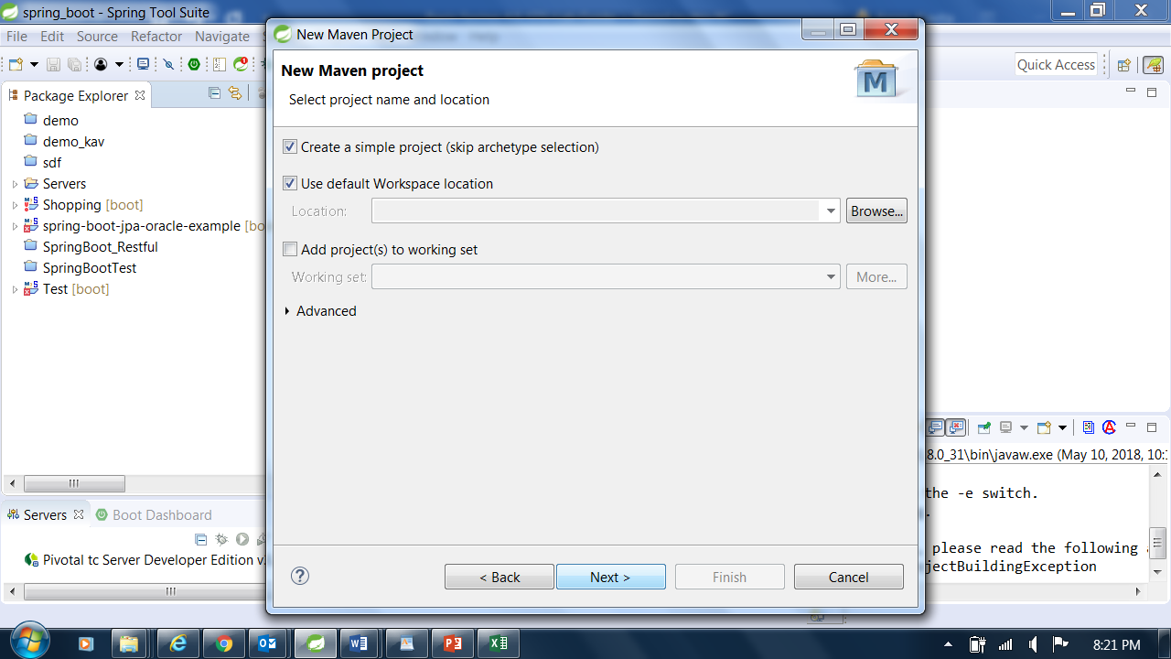
Creating a spring boot application using STS IDE Select the checkbox, “Create a simple project” and Click On Next-

Slide 7
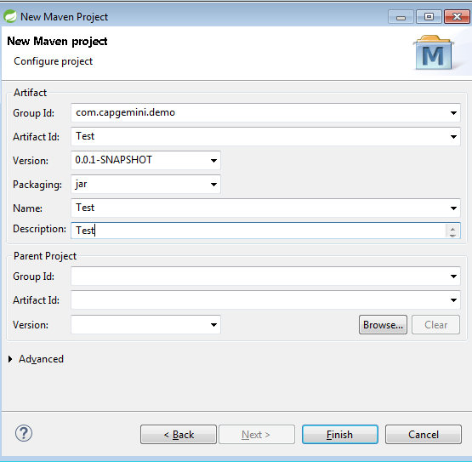
Specify the group id, artifact Id, name and description Click On Finish. Observe the folder structure of the newly created project

Slide 8
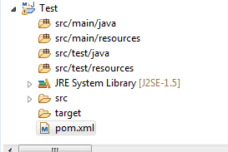
Double click on the generated pom.xml file

Slide 9

The default pom.xml is shown below

Slide 10
Add the following code in the pom.xml under the <description> tag
<parent>
<groupId>org.springframework.boot</groupId>
<artifactId>spring-boot-starter-parent</artifactId>
<version>2.0.1.RELEASE</version>
<relativePath /> <!-- lookup parent from repository -->
</parent>
<dependencies>
<dependency>
<groupId>org.springframework.boot</groupId>
<artifactId>spring-boot-starter-web</artifactId>
</dependency>
</dependencies>
Notes:
<parent>
<groupId>org.springframework.boot</groupId>
<artifactId>spring-boot-starter-parent</artifactId>
<version>2.0.1.RELEASE</version>
<relativePath /> <!-- lookup parent from repository -->
</parent>
Above entry will bring in all the dependency management features of Spring boot .
There is no need to declare all the dependencies one by one in pom.xml
<dependencies>
<dependency>
<groupId>org.springframework.boot</groupId>
<artifactId>spring-boot-starter-web</artifactId>
</dependency>
</dependencies>
Above will integrate Spring MVC and autoconfigure the project for us.
When u add the Spring boot starter web dependency in pom.xml, this brings in the Spring MVC sub framework dependency into the application.

Slide 11
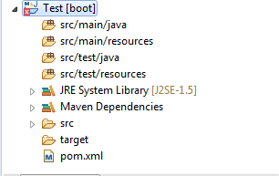
Observe that “Maven Dependencies” has been included into the project

Slide 12
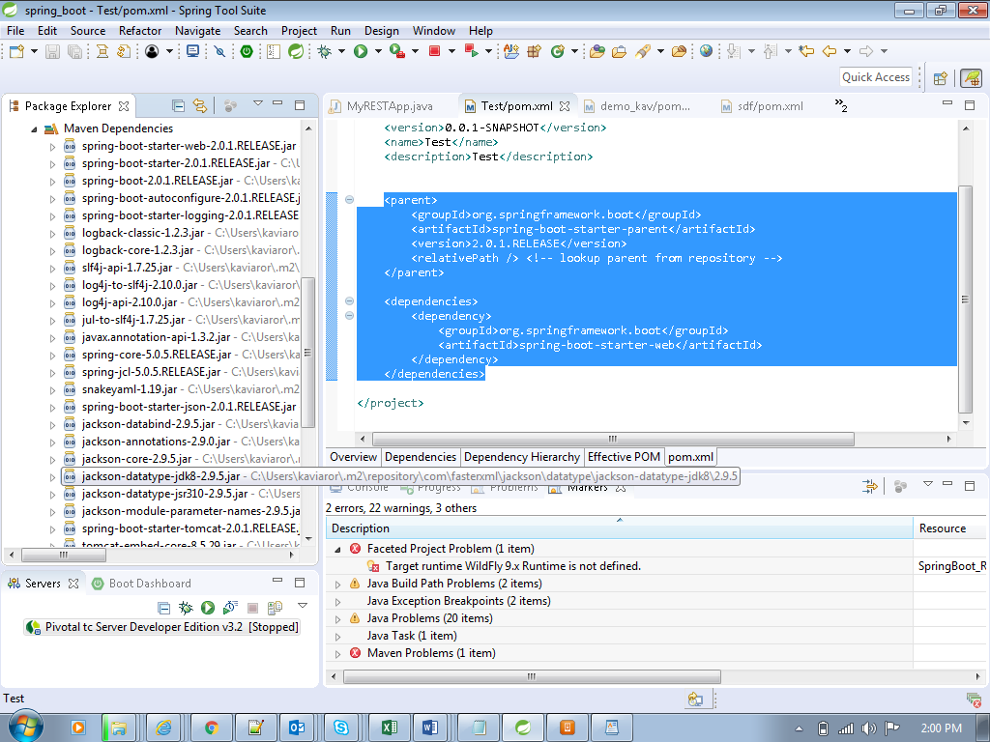
Without Spring Boot, these jar files are among those that you would have had to copy physically into the project

Slide 13
Create a new java class having the following code
@SpringBootApplication
public class Client {
public static void main(String[] args) {
SpringApplication.run(Client.class,args);
}
}
Run the above program as a regular java application
There is no need to deploy this application on any external server
Note: this class must be kept in the topmost package.
Notes:
SpringApplication.run(): Starts Spring, creates Spring context , applies annotations and sets up embedded container

Slide 14
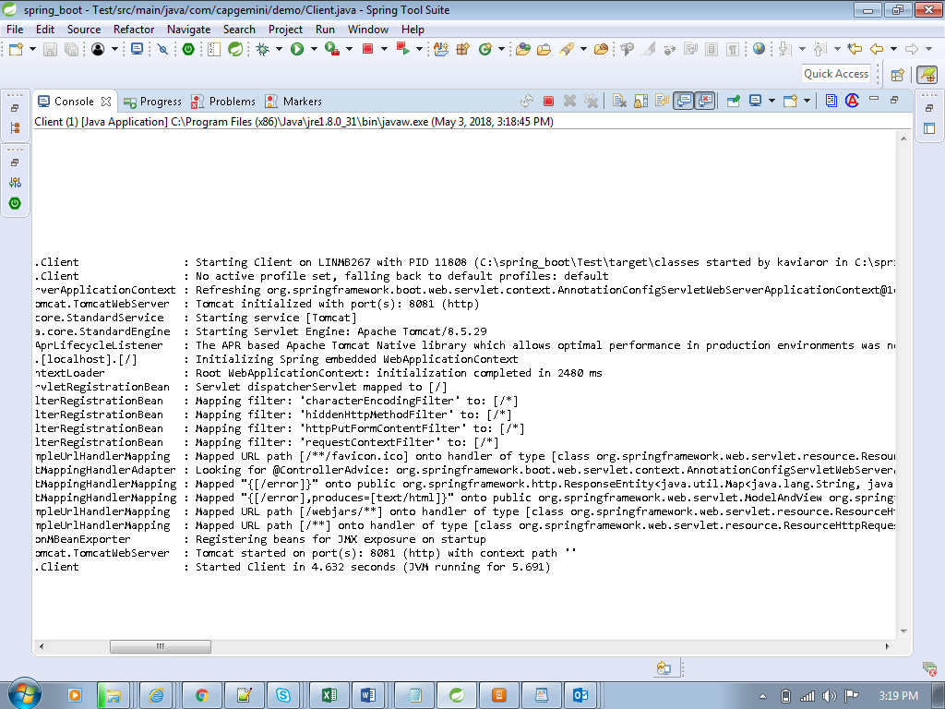
Run the application as a java application and observe the console as shown below

Slide 15
Create a class which acts as a controller
@RestController
public class HelloController {
@RequestMapping("/hello")
public String sayHi() {
return "Hi";
}
}
As we have not mapped any URLs to methods in the controller class, this step becomes necessary

Slide 16
Creating a spring boot application using STS IDE
After adding the controller class, navigate to browser and type http://localhost:8081/hello
And observe the “Hi” message displayed on the browser page
We have a fully running Java spring web application developed using Spring boot
Rapid application development is what Spring boot is about.
Notes:
Use the following to change the default port 8080 on which Tomcat listens
application.properties file
src ->main ->resources .. keep file here
server.port=8081

Slide 17
How Spring Boot works
The applicaton is started from the Java main class
2. Spring boot initialises Spring context that comprises the Spring app and honours autoconfig initialisers, configuration and annotations which direct how to initialise and startup the spring context
3. Embedded server container is started and autoconfigured
This removes the need for web.xml
Spring has chosen “Tomcat” as the default container

Slide 18
How Spring Boot works
@SpringBootApplication
A convenience annotation that wraps commonly used annotations.
Used in place of the following 3 different annotations
1. @configuration : Instructs that a Spring configuration class is being used instead of XML to define the components
2. @EnableAutoconfiguraton : is a Spring boot specific annotation
Instructs that the application should auto configure the other frameworks included as dependency with Spring.
3. @ComponentScan : Scans project for Spring components annotated with @Service, @Repository, @Component
Notes:
@EnableAutoconfiguration : This annotation told Spring boot to automatically set up so that we can use Spring controllers wihout doing any other integration work with MVC framework

Slide 19
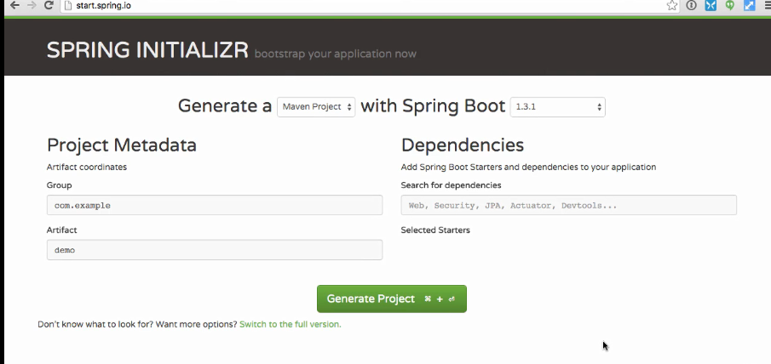
Spring Initializer
Navigate to the following URL
start.spring.io
Click on “switch to full version” link

Slide 20
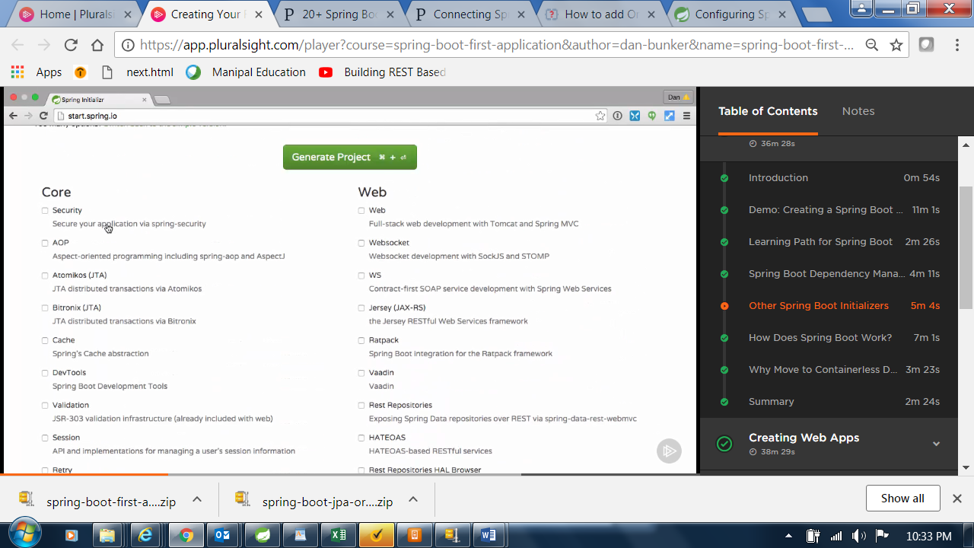
Select appropriate checkboxes which represent the different dependencies
you want to include in the project and then click on “Generate Project”
Observe the zip file created for you.
This contains the folder structure of the project

Slide 21
Spring boot command line interface
The Spring Boot CLI is a command line tool.
You don’t necessarily need to use the CLI to work with Spring Boot
You can download the Spring CLI distribution from the Spring software repository
spring-boot-cli-xxx.BUILD-SNAPSHOT-bin.zip
Once downloaded, follow the instructions written in install.txt

Slide 22
Thoughts to ponder
Why move to containerless deployment
Why run the application as a plain Java program

Slide 23
Container deployments
Make a jar file of the application and deploy on the container
Pre setup and configuration required
Need to use files like web.xml to tell the container how to work
Environmental configuration may be required. eg JNDI

Slide 24
Application deployments
When container is bundled inside the application, it is a better choice as
The applications runs anywhere that Java is setup
No need to find hosting environment
Container is embedded inside the application which tells the container how to set up the app so that it can be access via HTTP
Environmental configuration is internal to the application

Slide 25
Demo
1. Simple Java application using Spring Boot
2. Restful web application using Spring Boot
3. Spring boot application which integrates with Spring Data JPA

Slide 26
Summary
What we have seen so far:
What is Spring Boot and how it works
Create a Java application up and running using Spring Boot
Create a Restful web application using Spring Boot
Create a Spring boot application which integrates with Spring Data JPA
Notes:
Add the notes here
Trainer can summarize the points

Slide 27
Review Question
Question 1:
Question 2:
Question 3:
Notes:
Add the notes here.
Question 1: Option 2
Question 2: True
Question 3: SOAP messages

